Slide 1
Vector and Parametric Equations of a Plane

Slide 2
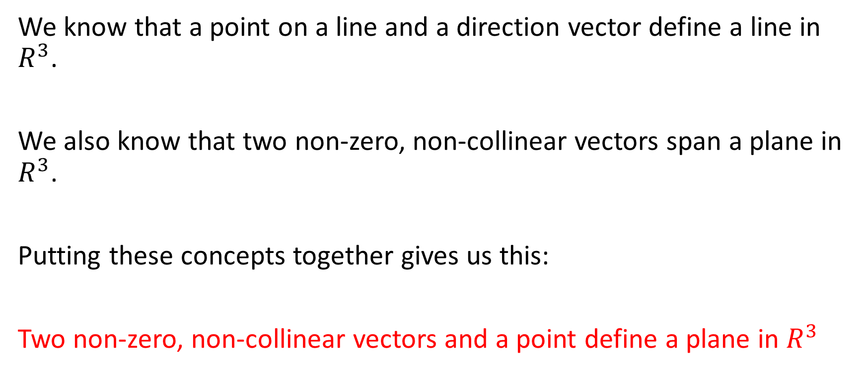
We know that a point on a line and a direction vector define a line in $R^{3}$.
We also know that two non-zero, non-collinear vectors span a plane in $R^{3}$.
Putting these concepts together gives us this:
Two non-zero, non-collinear vectors and a point define a plane in $R^{3}$

Slide 3

Example
State the vector and parametric equations of a plane in $R^{3}$ that contains the point $(8,−1,4)$ and the direction vectors $\vec{m_{1}}=\vec{(3,−9,4)}$ and $\vec{m_{2}}=\vec{(0,1,−2)}$

Slide 4
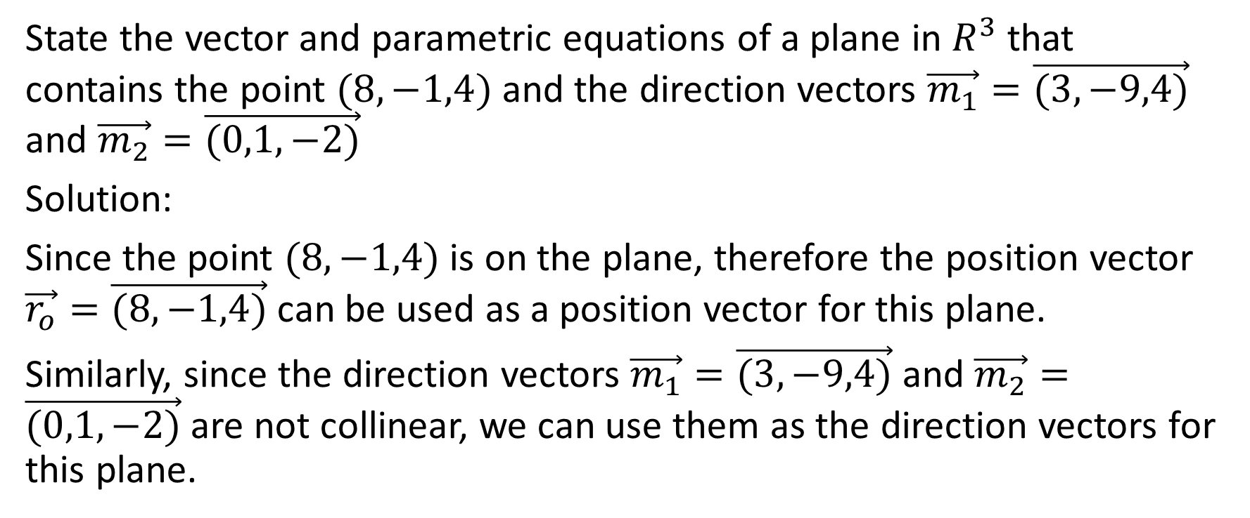
Example
State the vector and parametric equations of a plane in $R^{3}$ that contains the point $(8,−1,4)$ and the direction vectors $\vec{m_{1}}=\vec{(3,−9,4)}$ and $\vec{m_{2}}=\vec{(0,1,−2)}$
Solution:
Since the point $(8,−1,4)$ is on the plane, therefore the position vector $\vec{r_{o}}=\vec{(8,−1,4)}$ can be used as a position vector for this plane.
Similarly, since the direction vectors $\vec{m_{1}}=\vec{(3,−9,4)}$ and $\vec{m_{2}}=\vec{(0,1,−2)}$ are not collinear, we can use them as the direction vectors for this plane.

Slide 5

Therefore the vector equation of this plane is
$$\vec{r}=\vec{(8,−1,4)}+s\vec{(3,−9,4)}+t\vec{(0,1,−2)}, s,t ∈R$$

Slide 6

Therefore the vector equation of this plane is
$$\vec{r}=\vec{(8,−1,4)}+s\vec{(3,−9,4)}+t\vec{(0,1,−2)}, s,t ∈R$$
Notice that we use different parameters for the two different direction vectors because a particular point on the plane may be associated with different parameter values for $s$ and for $t$.

Slide 7
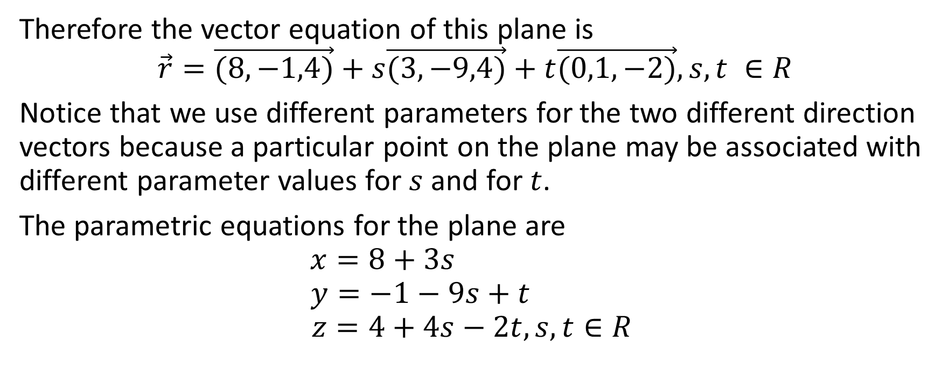
Therefore the vector equation of this plane is
$$\vec{r}=\vec{(8,−1,4)}+s\vec{(3,−9,4)}+t\vec{(0,1,−2)}, s,t ∈R$$
Notice that we use different parameters for the two different direction vectors because a particular point on the plane may be associated with different parameter values for $s$ and for $t$.
The parametric equations for the plane are
$$x=8+3s$$
$$y=−1−9s+t$$
$$z=4+4s−2t, s,t∈R$$

Slide 8

Example
Given the vector equation
$$\vec{r}=\vec{(8,−1,4)}+s\vec{(3,−9,4)}+t\vec{(0,1,−2)}, s,t ∈R$$
And the parametric equations
$$x=8+3s$$
$$y=−1−9s+t$$
$$z=4+4s−2t, s,t∈R$$
state three other points on the plane.

Slide 9

Given the vector equation
$$\vec{r}=\vec{(8,−1,4)}+s\vec{(3,−9,4)}+t\vec{(0,1,−2)}, s,t ∈R$$
And the parametric equations
$$x=8+3s$$
$$y=−1−9s+t$$
$$z=4+4s−2t, s,t∈R$$
state three other points on the plane.
Solution:
We can just give the parameters $s$ and $t$ any pair of values
First Point: For example, let $s=−2$ and $t=3$

Slide 10
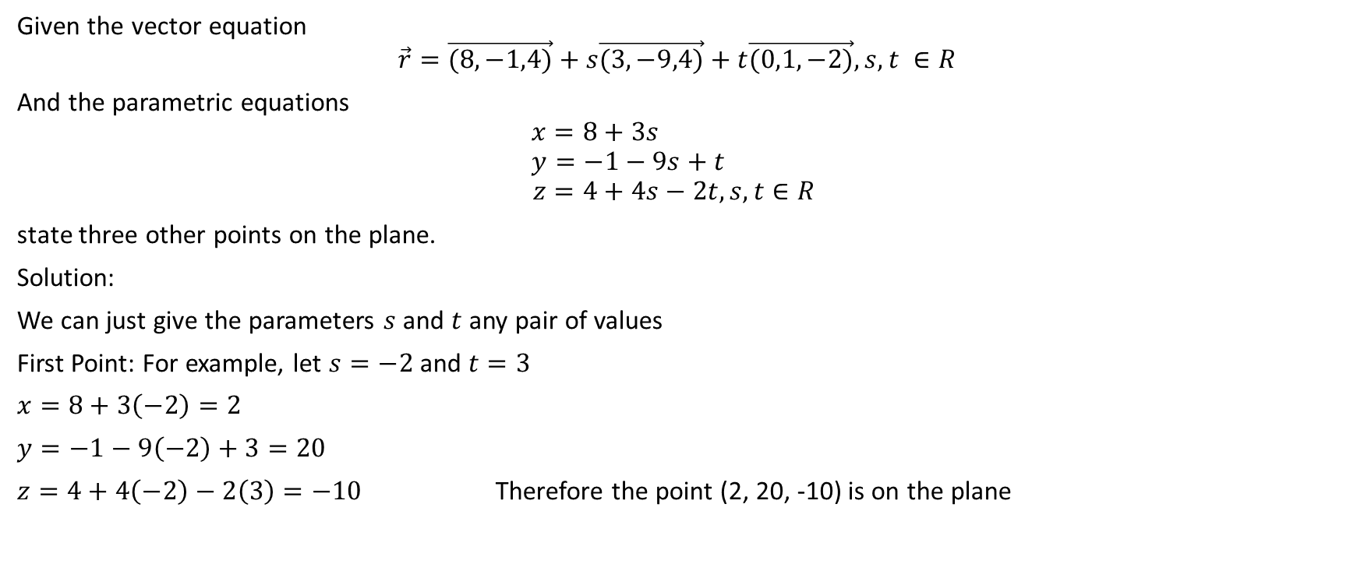
Given the vector equation
$$\vec{r}=\vec{(8,−1,4)}+s\vec{(3,−9,4)}+t\vec{(0,1,−2)}, s,t ∈R$$
And the parametric equations
$$x=8+3s$$
$$y=−1−9s+t$$
$$z=4+4s−2t, s,t∈R$$
state three other points on the plane.
Solution:
We can just give the parameters $s$ and $t$ any pair of values
First Point: For example, let $s=−2$ and $t=3$
$x=8+3\left(−2\right)=2$
$y=−1−9\left(−2\right)+3=20$
$z=4+4\left(−2\right)−2\left(3\right)=−10$ Therefore the point (2, 20, -10) is on the plane

Slide 11

Given the vector equation
$$\vec{r}=\vec{(8,−1,4)}+s\vec{(3,−9,4)}+t\vec{(0,1,−2)}, s,t ∈R$$
And the parametric equations
$$x=8+3s$$
$$y=−1−9s+t$$
$$z=4+4s−2t, s,t∈R$$
state three other points on the plane.
Solution:
We can just give the parameters $s$ and $t$ any pair of values
Second Point: For example, let $s=$ 5 and $t=0$

Slide 12
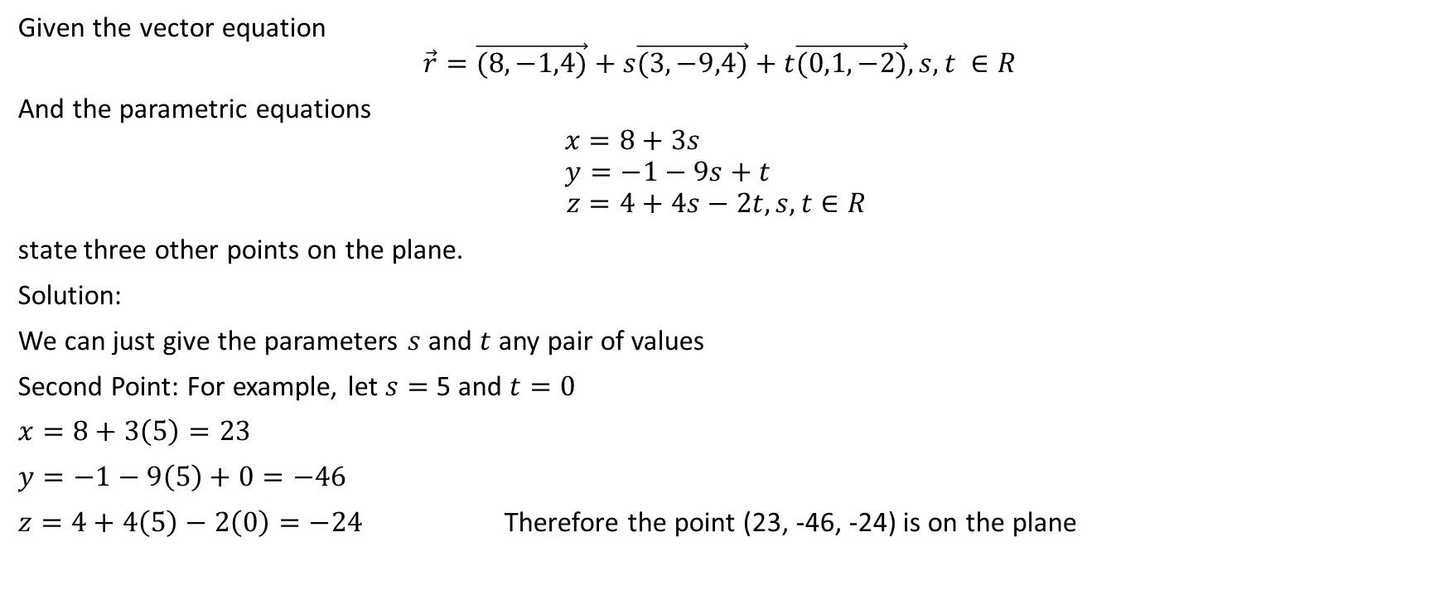
Given the vector equation
$$\vec{r}=\vec{(8,−1,4)}+s\vec{(3,−9,4)}+t\vec{(0,1,−2)}, s,t ∈R$$
And the parametric equations
$$x=8+3s$$
$$y=−1−9s+t$$
$$z=4+4s−2t, s,t∈R$$
state three other points on the plane.
Solution:
We can just give the parameters $s$ and $t$ any pair of values
Second Point: For example, let $s=$ 5 and $t=0$
$x=8+3\left(5\right)=23$
$y=−1−9\left(5\right)+0=−46$
$z=4+4\left(5\right)−2\left(0\right)=−24$ Therefore the point (23, -46, -24) is on the plane

Slide 13

Given the vector equation
$$\vec{r}=\vec{(8,−1,4)}+s\vec{(3,−9,4)}+t\vec{(0,1,−2)}, s,t ∈R$$
And the parametric equations
$$x=8+3s$$
$$y=−1−9s+t$$
$$z=4+4s−2t, s,t∈R$$
state three other points on the plane.
Solution:
We can just give the parameters $s$ and $t$ any pair of values
Third Point: For example, let $s=−11$ and $t=38$

Slide 14
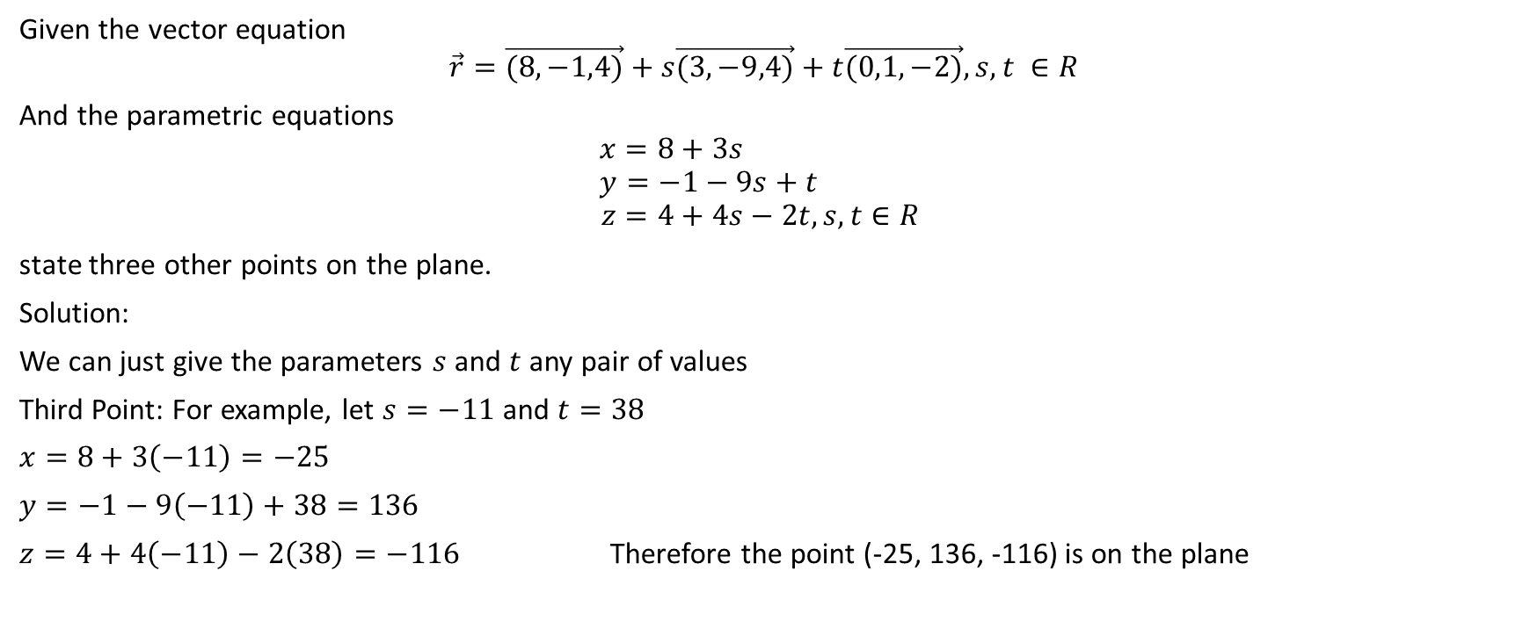
Given the vector equation
$$\vec{r}=\vec{(8,−1,4)}+s\vec{(3,−9,4)}+t\vec{(0,1,−2)}, s,t ∈R$$
And the parametric equations
$$x=8+3s$$
$$y=−1−9s+t$$
$$z=4+4s−2t, s,t∈R$$
state three other points on the plane.
Solution:
We can just give the parameters $s$ and $t$ any pair of values
Third Point: For example, let $s=−11$ and $t=38$
$x=8+3\left(−11\right)=−25$
$y=−1−9\left(−11\right)+38=136$
$z=4+4\left(−11\right)−2\left(38\right)=−116$ Therefore the point (-25, 136, -116) is on the plane

Slide 15
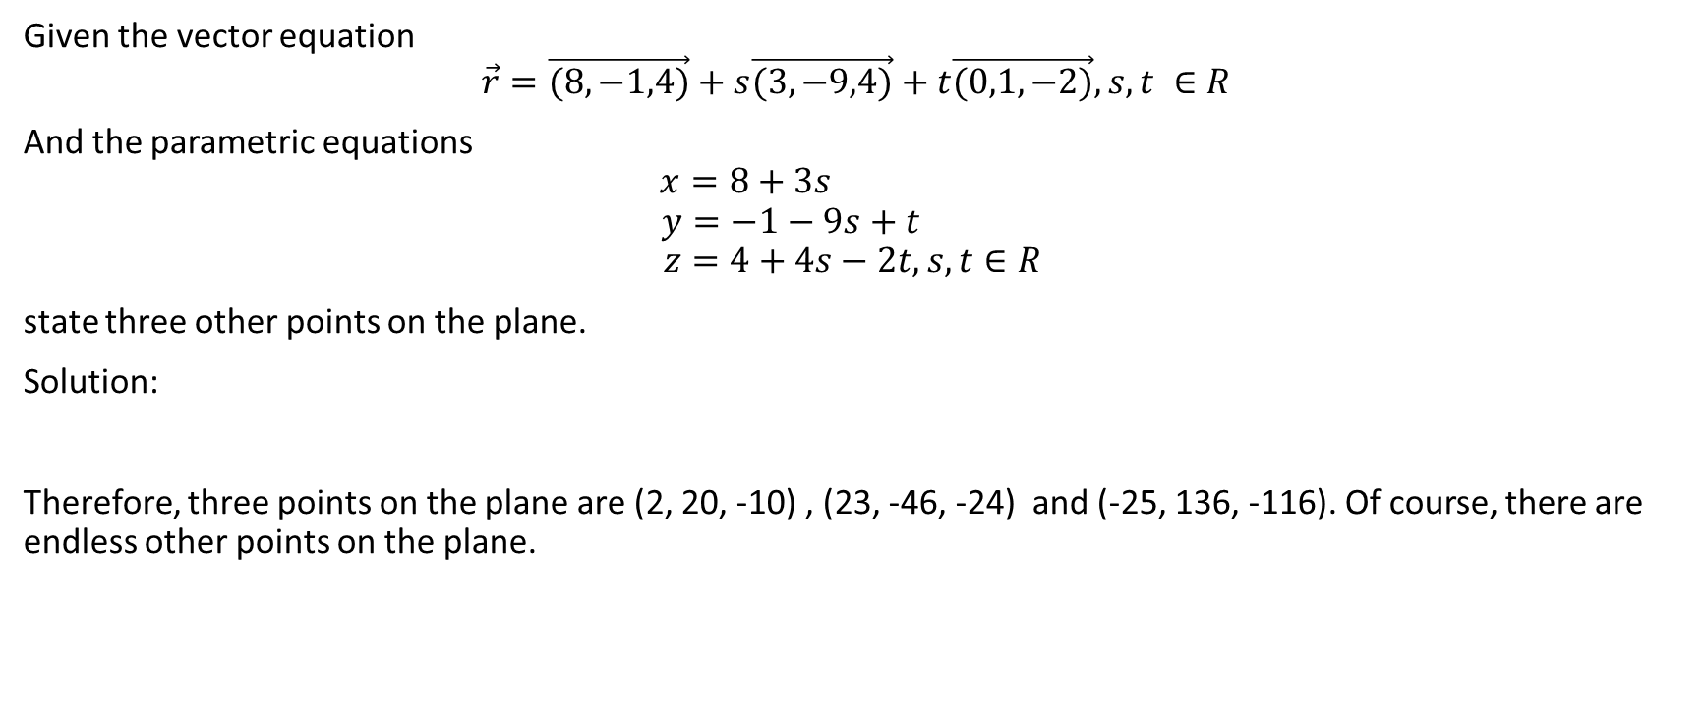
Given the vector equation
$$\vec{r}=\vec{(8,−1,4)}+s\vec{(3,−9,4)}+t\vec{(0,1,−2)}, s,t ∈R$$
And the parametric equations
$$x=8+3s$$
$$y=−1−9s+t$$
$$z=4+4s−2t, s,t∈R$$
state three other points on the plane.
Solution:
Therefore, three points on the plane are (2, 20, -10) , (23, -46, -24) and (-25, 136, -116). Of course, there are endless other points on the plane.

Slide 16

Example
Given the vector equation
$$\vec{r}=\vec{(9,2,−3)}+s\vec{(8,5,2)}+t\vec{(2,1,−2)}, s,t ∈R$$
And the parametric equations
$$x=9+8s+2t$$
$$y=2+5s+t$$
$$z=−3+2s−2t, s,t∈R$$
determine whether the point (31, 16, 5) is on the plane

Slide 17
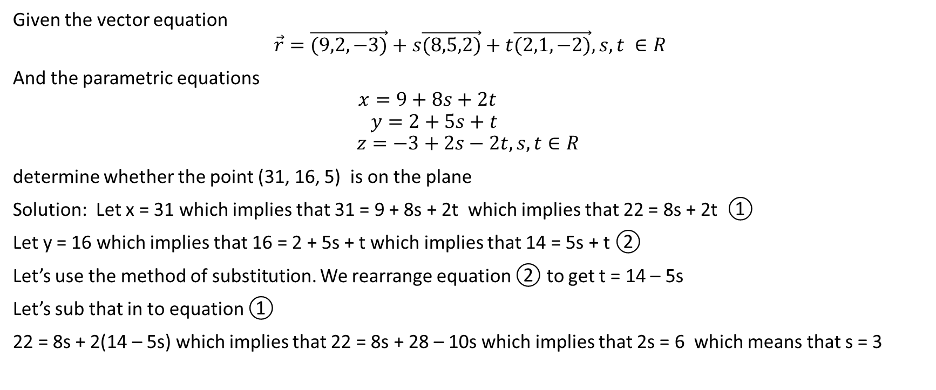
Given the vector equation
$$\vec{r}=\vec{(9,2,−3)}+s\vec{(8,5,2)}+t\vec{(2,1,−2)}, s,t ∈R$$
And the parametric equations
$$x=9+8s+2t$$
$$y=2+5s+t$$
$$z=−3+2s−2t, s,t∈R$$
determine whether the point (31, 16, 5) is on the plane
Solution: Let x = 31 which implies that 31 = 9 + 8s + 2t which implies that 22 = 8s + 2t ①
Let y = 16 which implies that 16 = 2 + 5s + t which implies that 14 = 5s + t ②
Let’s use the method of substitution. We rearrange equation ② to get t = 14 – 5s
Let’s sub that in to equation ①
22 = 8s + 2(14 – 5s) which implies that 22 = 8s + 28 – 10s which implies that 2s = 6 which means that s = 3

Slide 18
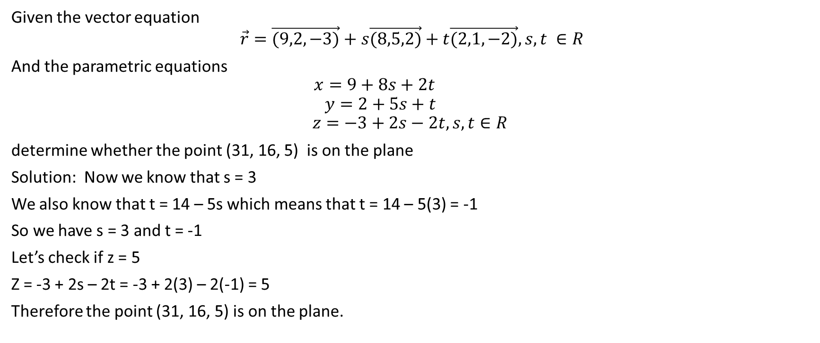
Given the vector equation
$$\vec{r}=\vec{(9,2,−3)}+s\vec{(8,5,2)}+t\vec{(2,1,−2)}, s,t ∈R$$
And the parametric equations
$$x=9+8s+2t$$
$$y=2+5s+t$$
$$z=−3+2s−2t, s,t∈R$$
determine whether the point (31, 16, 5) is on the plane
Solution: Now we know that s = 3
We also know that t = 14 – 5s which means that t = 14 – 5(3) = -1
So we have s = 3 and t = -1
Let’s check if z = 5
Z = -3 + 2s – 2t = -3 + 2(3) – 2(-1) = 5
Therefore the point (31, 16, 5) is on the plane.

Slide 19
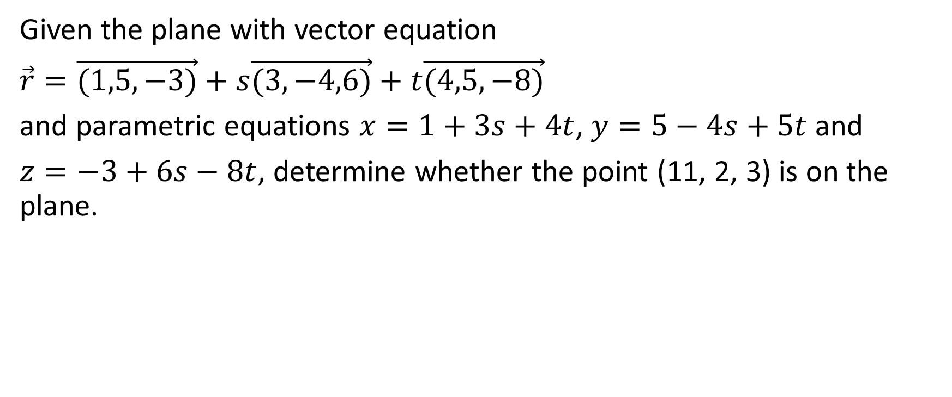
Example
Given the plane with vector equation
$\vec{r}=\vec{(1,5,−3)}+s\vec{(3,−4,6)}+t\vec{(4,5,−8)}$
and parametric equations $x=1+3s+4t$, $y=5−4s+5t$ and
$z=−3+6s−8t$, determine whether the point (11, 2, 3) is on the plane.

Slide 20
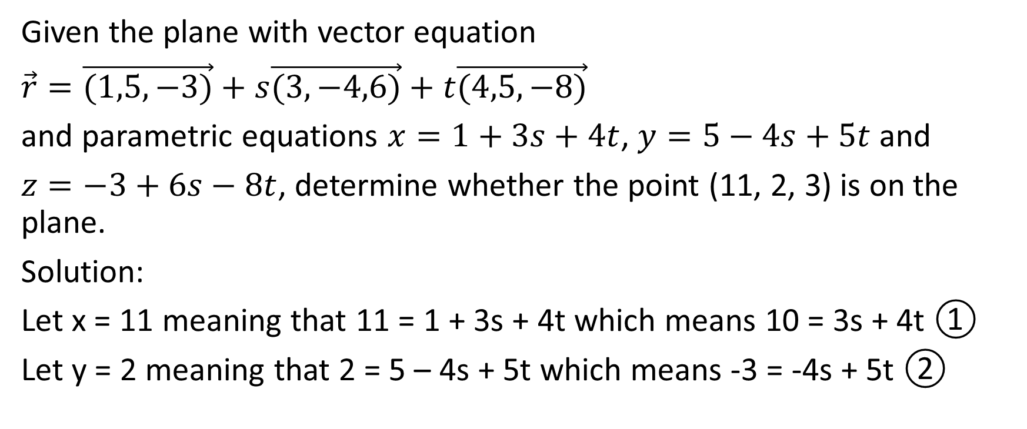
Given the plane with vector equation
$\vec{r}=\vec{(1,5,−3)}+s\vec{(3,−4,6)}+t\vec{(4,5,−8)}$
and parametric equations $x=1+3s+4t$, $y=5−4s+5t$ and
$z=−3+6s−8t$, determine whether the point (11, 2, 3) is on the plane.
Solution:
Let x = 11 meaning that 11 = 1 + 3s + 4t which means 10 = 3s + 4t ①
Let y = 2 meaning that 2 = 5 – 4s + 5t which means -3 = -4s + 5t ②

Slide 21
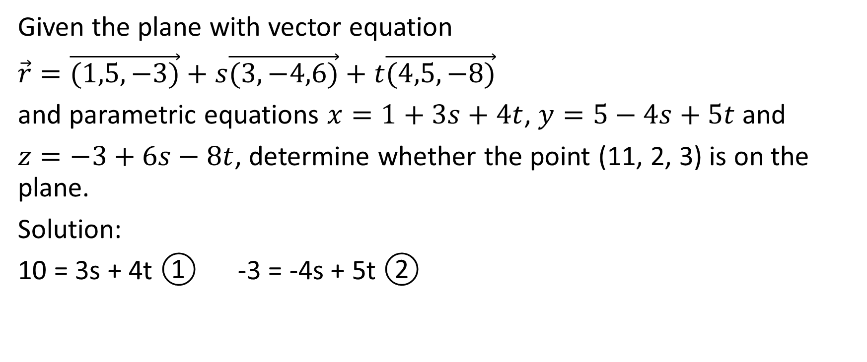
Given the plane with vector equation
$\vec{r}=\vec{(1,5,−3)}+s\vec{(3,−4,6)}+t\vec{(4,5,−8)}$
and parametric equations $x=1+3s+4t$, $y=5−4s+5t$ and
$z=−3+6s−8t$, determine whether the point (11, 2, 3) is on the plane.
Solution:
10 = 3s + 4t ① -3 = -4s + 5t ②

Slide 22
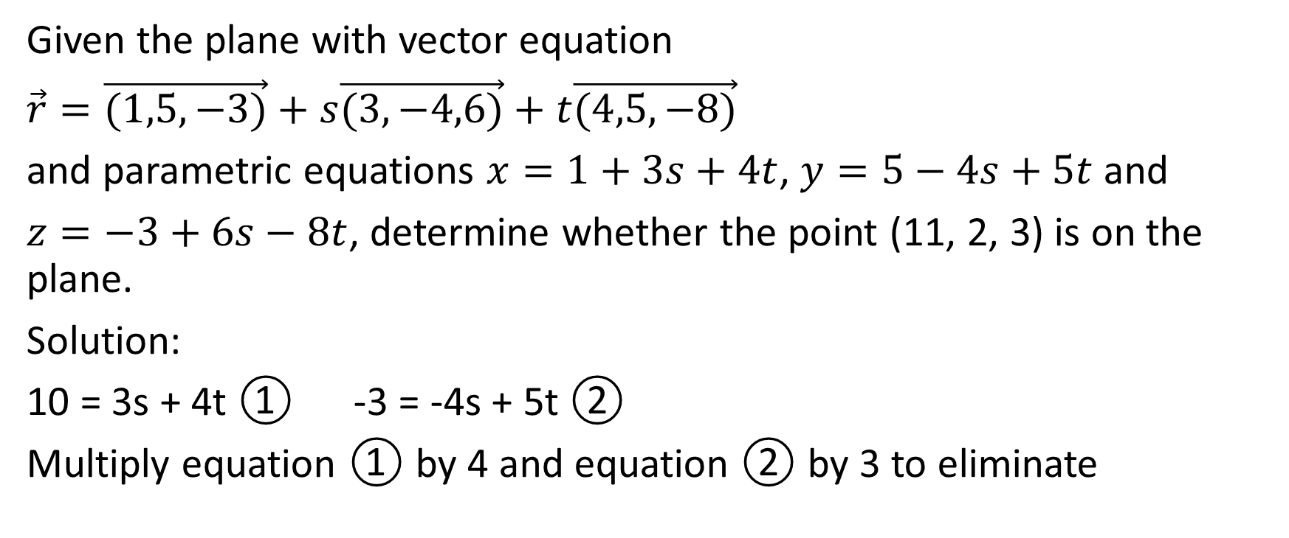
Given the plane with vector equation
$\vec{r}=\vec{(1,5,−3)}+s\vec{(3,−4,6)}+t\vec{(4,5,−8)}$
and parametric equations $x=1+3s+4t$, $y=5−4s+5t$ and
$z=−3+6s−8t$, determine whether the point (11, 2, 3) is on the plane.
Solution:
10 = 3s + 4t ① -3 = -4s + 5t ②
Multiply equation ① by 4 and equation ② by 3 to eliminate

Slide 23
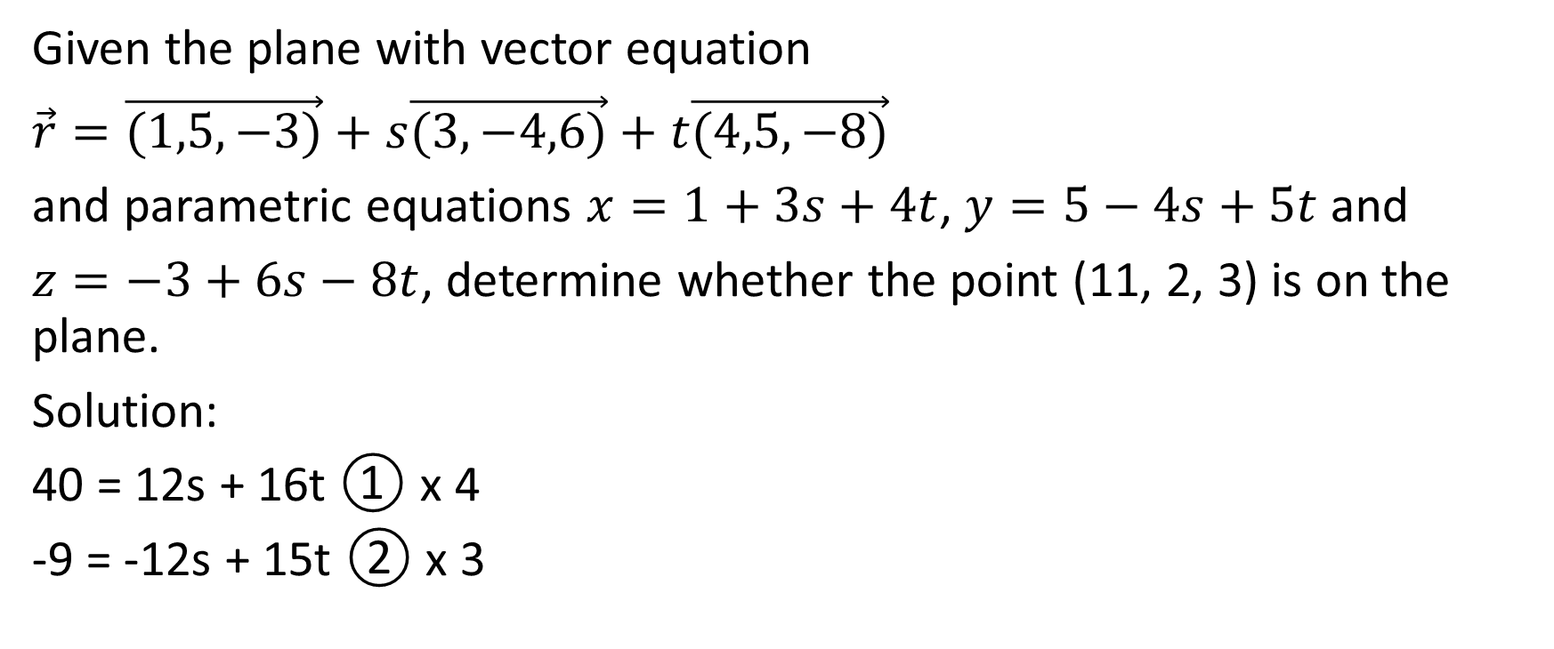
Given the plane with vector equation
$\vec{r}=\vec{(1,5,−3)}+s\vec{(3,−4,6)}+t\vec{(4,5,−8)}$
and parametric equations $x=1+3s+4t$, $y=5−4s+5t$ and
$z=−3+6s−8t$, determine whether the point (11, 2, 3) is on the plane.
Solution:
40 = 12s + 16t ① x 4
-9 = -12s + 15t ② x 3

Slide 24
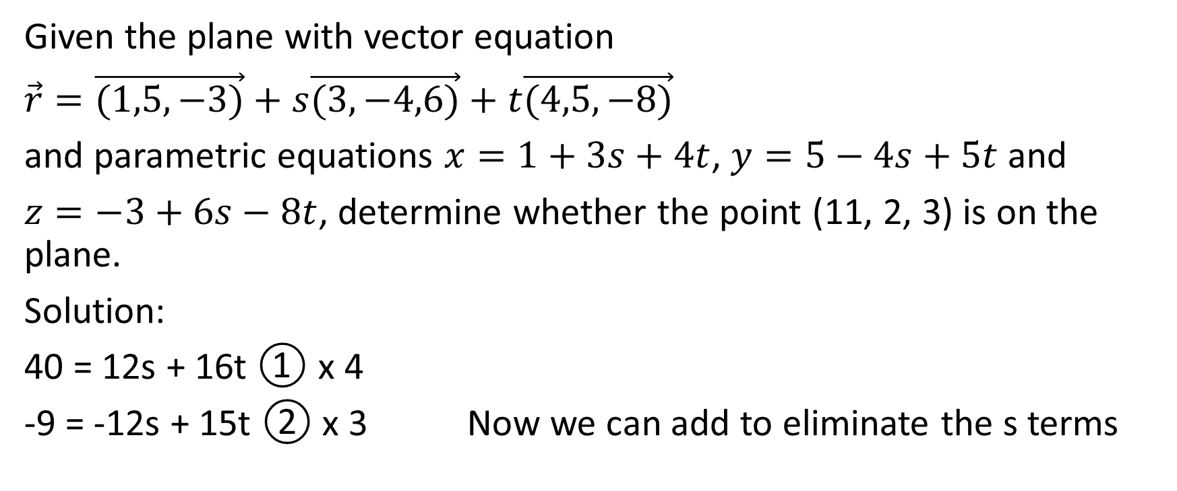
Given the plane with vector equation
$\vec{r}=\vec{(1,5,−3)}+s\vec{(3,−4,6)}+t\vec{(4,5,−8)}$
and parametric equations $x=1+3s+4t$, $y=5−4s+5t$ and
$z=−3+6s−8t$, determine whether the point (11, 2, 3) is on the plane.
Solution:
40 = 12s + 16t ① x 4
-9 = -12s + 15t ② x 3 Now we can add to eliminate the s terms

Slide 25
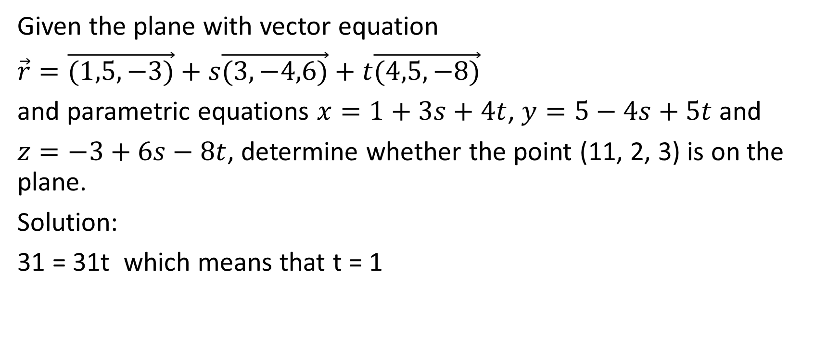
Given the plane with vector equation
$\vec{r}=\vec{(1,5,−3)}+s\vec{(3,−4,6)}+t\vec{(4,5,−8)}$
and parametric equations $x=1+3s+4t$, $y=5−4s+5t$ and
$z=−3+6s−8t$, determine whether the point (11, 2, 3) is on the plane.
Solution:
31 = 31t which means that t = 1

Slide 26
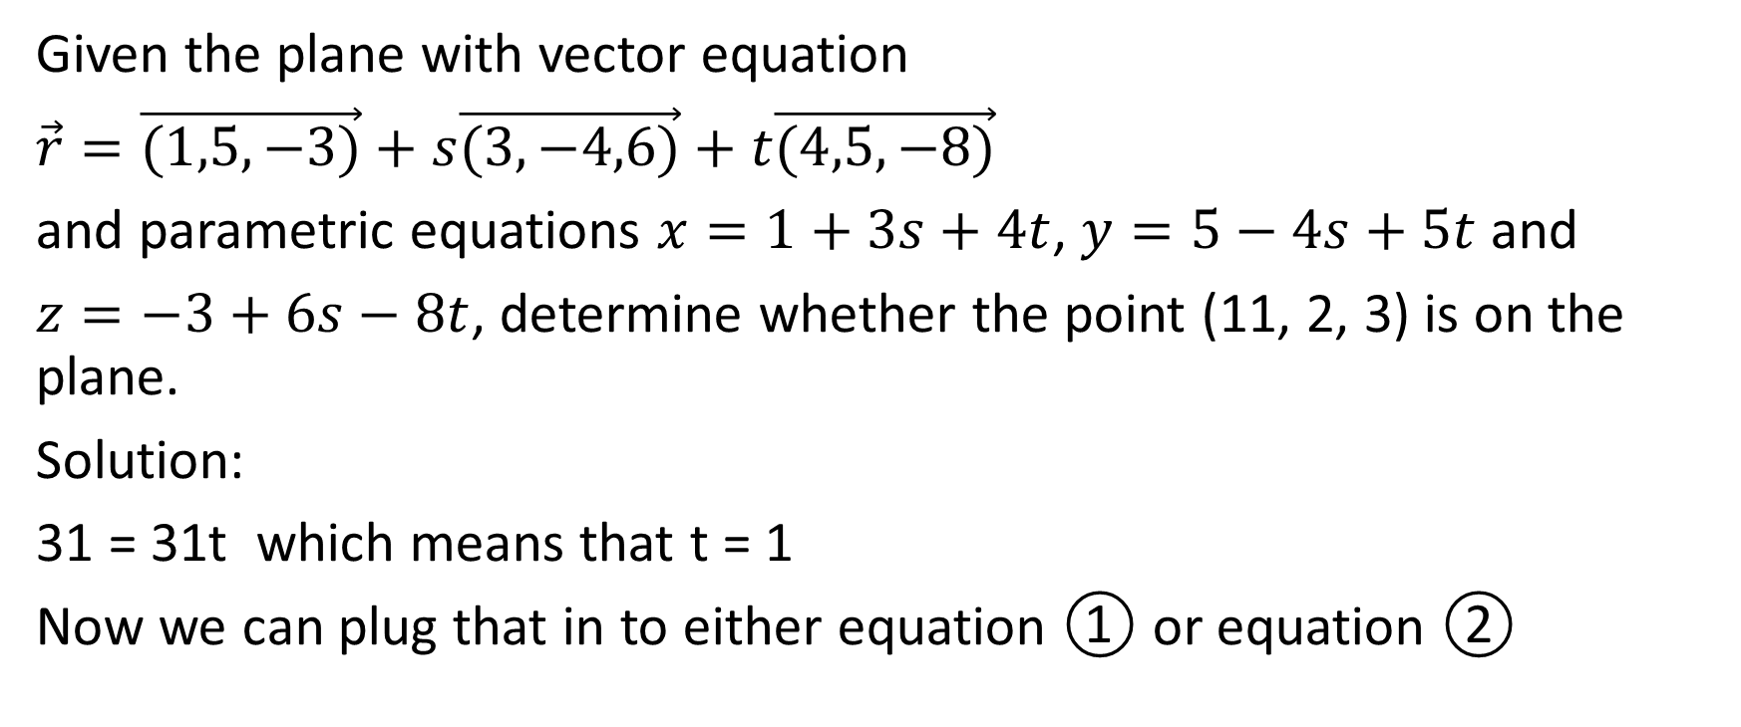
Given the plane with vector equation
$\vec{r}=\vec{(1,5,−3)}+s\vec{(3,−4,6)}+t\vec{(4,5,−8)}$
and parametric equations $x=1+3s+4t$, $y=5−4s+5t$ and
$z=−3+6s−8t$, determine whether the point (11, 2, 3) is on the plane.
Solution:
31 = 31t which means that t = 1
Now we can plug that in to either equation ① or equation ②

Slide 27
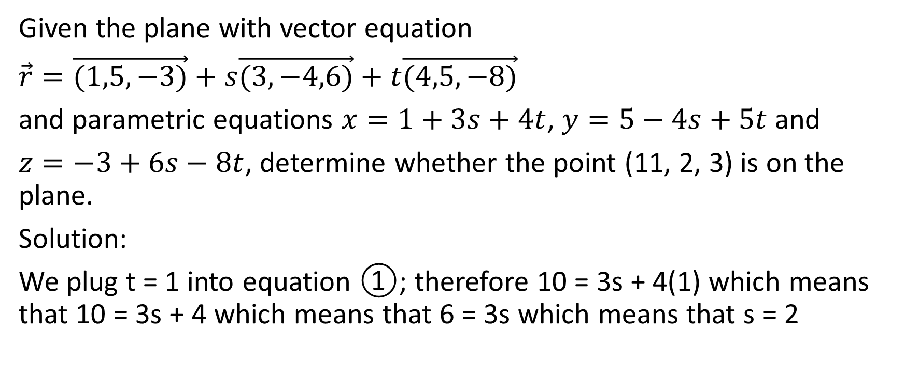
Given the plane with vector equation
$\vec{r}=\vec{(1,5,−3)}+s\vec{(3,−4,6)}+t\vec{(4,5,−8)}$
and parametric equations $x=1+3s+4t$, $y=5−4s+5t$ and
$z=−3+6s−8t$, determine whether the point (11, 2, 3) is on the plane.
Solution:
We plug t = 1 into equation ①; therefore 10 = 3s + 4(1) which means that 10 = 3s + 4 which means that 6 = 3s which means that s = 2

Slide 28
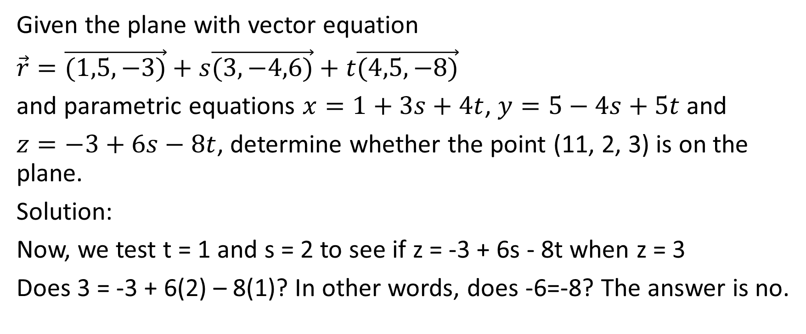
Given the plane with vector equation
$\vec{r}=\vec{(1,5,−3)}+s\vec{(3,−4,6)}+t\vec{(4,5,−8)}$
and parametric equations $x=1+3s+4t$, $y=5−4s+5t$ and
$z=−3+6s−8t$, determine whether the point (11, 2, 3) is on the plane.
Solution:
Now, we test t = 1 and s = 2 to see if z = -3 + 6s - 8t when z = 3
Does 3 = -3 + 6(2) – 8(1)? In other words, does -6=-8? The answer is no.

Slide 29
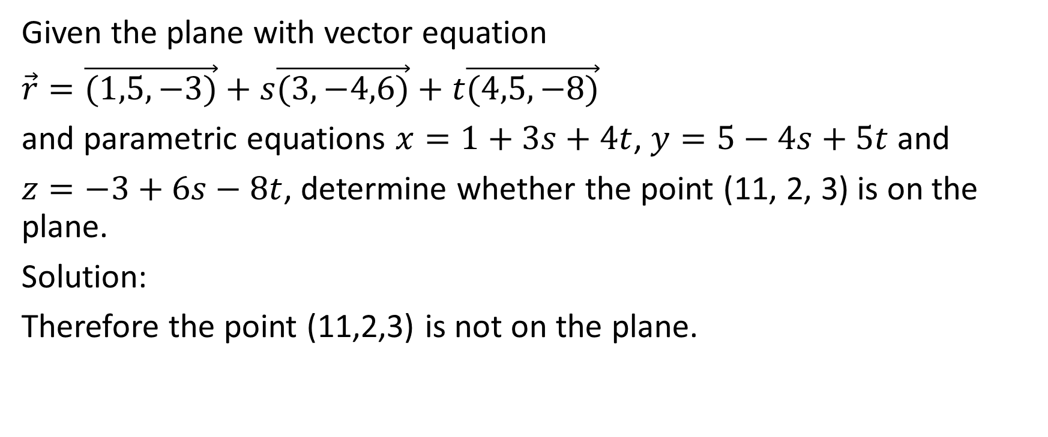
Given the plane with vector equation
$\vec{r}=\vec{(1,5,−3)}+s\vec{(3,−4,6)}+t\vec{(4,5,−8)}$
and parametric equations $x=1+3s+4t$, $y=5−4s+5t$ and
$z=−3+6s−8t$, determine whether the point (11, 2, 3) is on the plane.
Solution:
Therefore the point (11,2,3) is not on the plane.

Slide 30
In summary, to determine whether a given point is on a given plane when the plane is written in vector form or in parametric form, we need to get the plane into parametric form. Then, we can set the x-coordinate of the point in question equal to the parametric expression for x and we set the y-coordinate of the point in question equal to the parametric expression for y. Then, we usually use substitution or elimination to solve for the parameters (usually s and t). Then, we plug those parameter values into the parametric expression for z and see if we get the required value of the z-coordinate.

Slide 31
More information about planes
One and only one plane can be determined if we are given any of the following:
a line and a point not on the line
three non-collinear points (three points not on a line)
two intersecting lines
two parallel and non-coincident lines

Slide 32
Example
Determine a vector equation and parametric equations for the plane containing the points A (6, 2, 1), B (9, -4, 2) and C (-1, -2, -3).

Slide 33
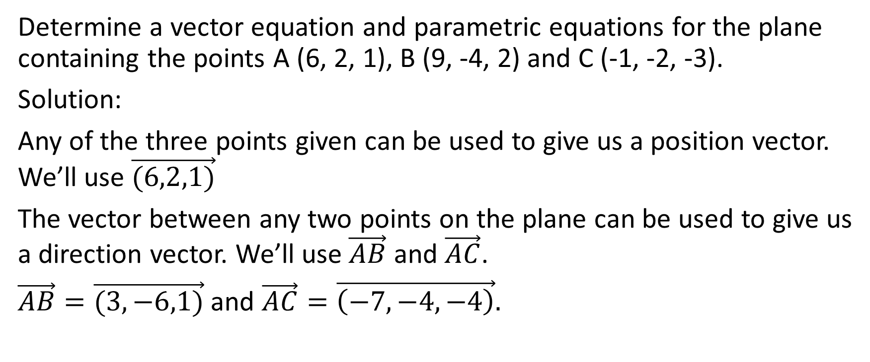
Determine a vector equation and parametric equations for the plane containing the points A (6, 2, 1), B (9, -4, 2) and C (-1, -2, -3).
Solution:
Any of the three points given can be used to give us a position vector. We’ll use $\vec{(6,2,1)}$
The vector between any two points on the plane can be used to give us a direction vector. We’ll use $\vec{AB}$ and $\vec{AC}$.
$\vec{AB}=\vec{(3,−6,1)}$ and $\vec{AC}=\vec{\left(−7,−4,−4\right)}.$

Slide 34
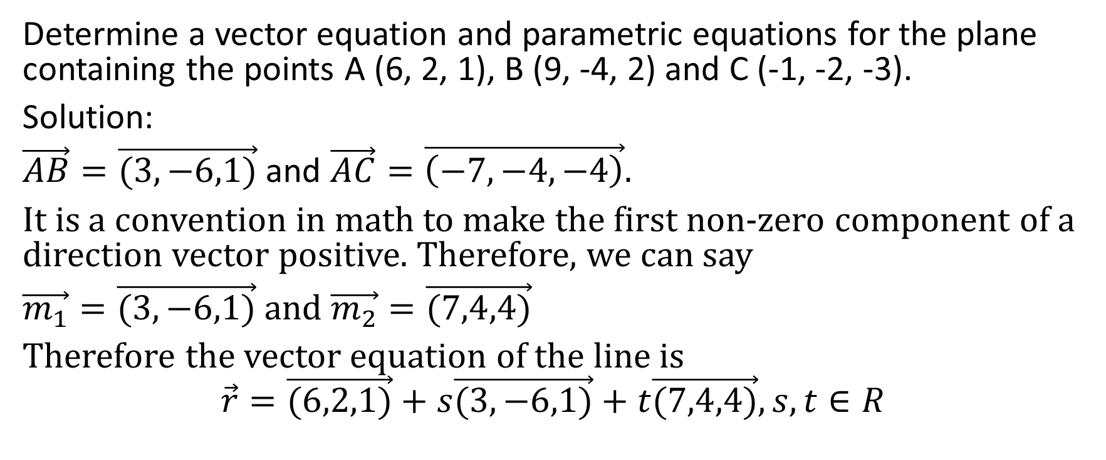
Determine a vector equation and parametric equations for the plane containing the points A (6, 2, 1), B (9, -4, 2) and C (-1, -2, -3).
Solution:
$\vec{AB}=\vec{(3,−6,1)}$ and $\vec{AC}=\vec{\left(−7,−4,−4\right)}.$
It is a convention in math to make the first non-zero component of a direction vector positive. Therefore, we can say
$\vec{m_{1}}=\vec{(3,−6,1)}$ and $\vec{m_{2}}=\vec{(7,4,4)}$
Therefore the vector equation of the line is
$$\vec{r}=\vec{(6,2,1)}+s\vec{(3,−6,1)}+t\vec{(7,4,4)}, s,t∈R$$

Slide 35

Determine a vector equation and parametric equations for the plane containing the points A (6, 2, 1), B (9, -4, 2) and C (-1, -2, -3).
Solution:
$$\vec{r}=\vec{(6,2,1)}+s\vec{(3,−6,1)}+t\vec{(7,4,4)}, s,t∈R$$

Slide 36
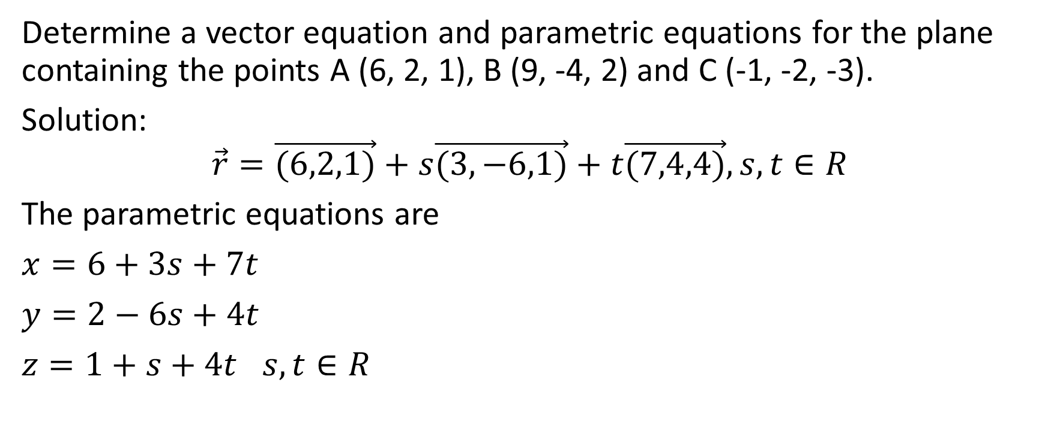
Determine a vector equation and parametric equations for the plane containing the points A (6, 2, 1), B (9, -4, 2) and C (-1, -2, -3).
Solution:
$$\vec{r}=\vec{(6,2,1)}+s\vec{(3,−6,1)}+t\vec{(7,4,4)}, s,t∈R$$
The parametric equations are
$x=6+3s+7t$
$y=2−6s+4t$
$z=1+s+4t$ $s,t∈R$

Slide 37
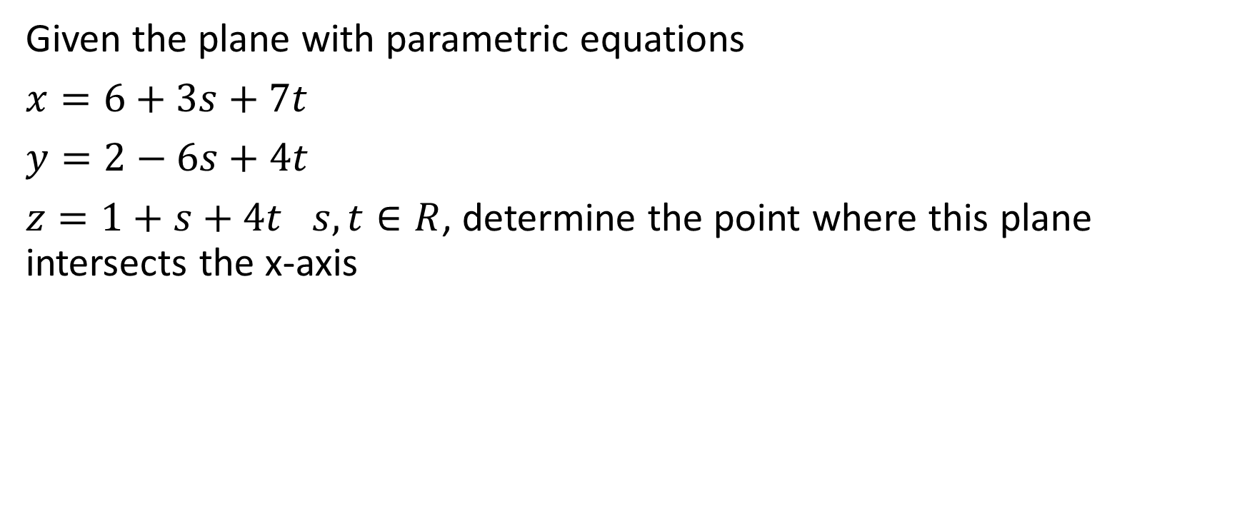
Example
Given the plane with parametric equations
$x=6+3s+7t$
$y=2−6s+4t$
$z=1+s+4t$ $s,t∈R$, determine the point where this plane intersects the x-axis

Slide 38
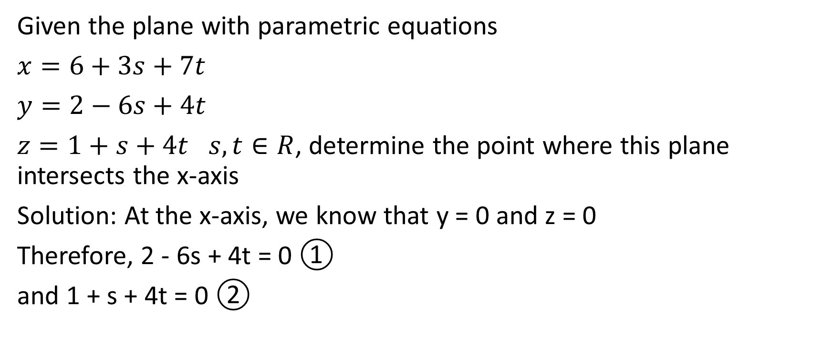
Given the plane with parametric equations
$x=6+3s+7t$
$y=2−6s+4t$
$z=1+s+4t$ $s,t∈R$, determine the point where this plane intersects the x-axis
Solution: At the x-axis, we know that y = 0 and z = 0
Therefore, 2 - 6s + 4t = 0 ①
and 1 + s + 4t = 0 ②

Slide 39
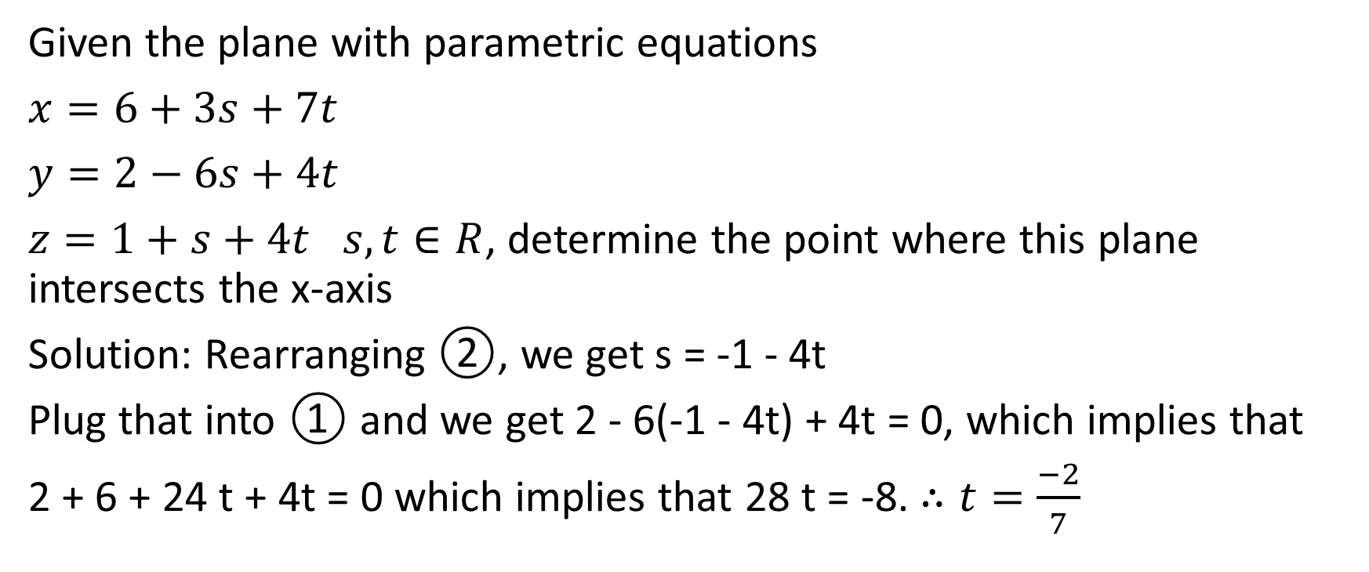
Given the plane with parametric equations
$x=6+3s+7t$
$y=2−6s+4t$
$z=1+s+4t$ $s,t∈R$, determine the point where this plane intersects the x-axis
Solution: Rearranging ②, we get s = -1 - 4t
Plug that into ① and we get 2 - 6(-1 - 4t) + 4t = 0, which implies that
2 + 6 + 24 t + 4t = 0 which implies that 28 t = -8. $∴t=\frac{−2}{7}$

Slide 40
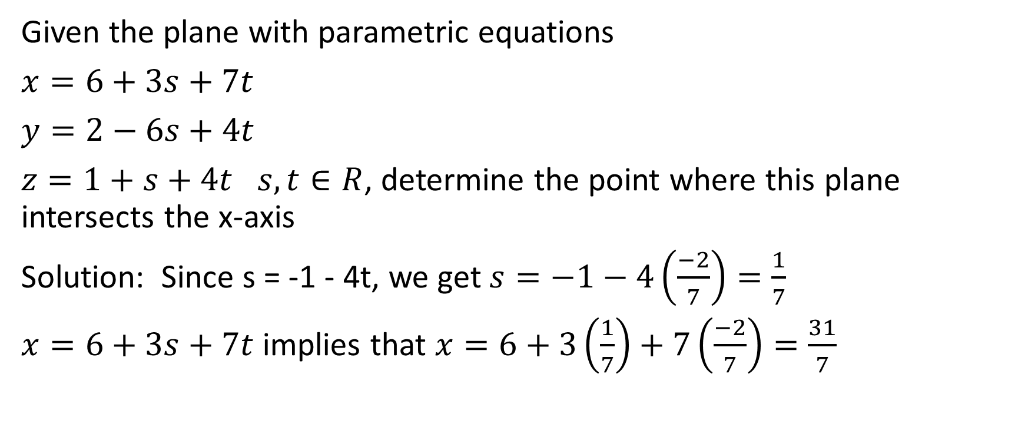
Given the plane with parametric equations
$x=6+3s+7t$
$y=2−6s+4t$
$z=1+s+4t$ $s,t∈R$, determine the point where this plane intersects the x-axis
Solution: Since s = -1 - 4t, we get $s=−1−4\left(\frac{−2}{7}\right)=\frac{1}{7}$
$x=6+3s+7t$ implies that $x=6+3\left(\frac{1}{7}\right)+7\left(\frac{−2}{7}\right)=\frac{31}{7}$

Slide 41
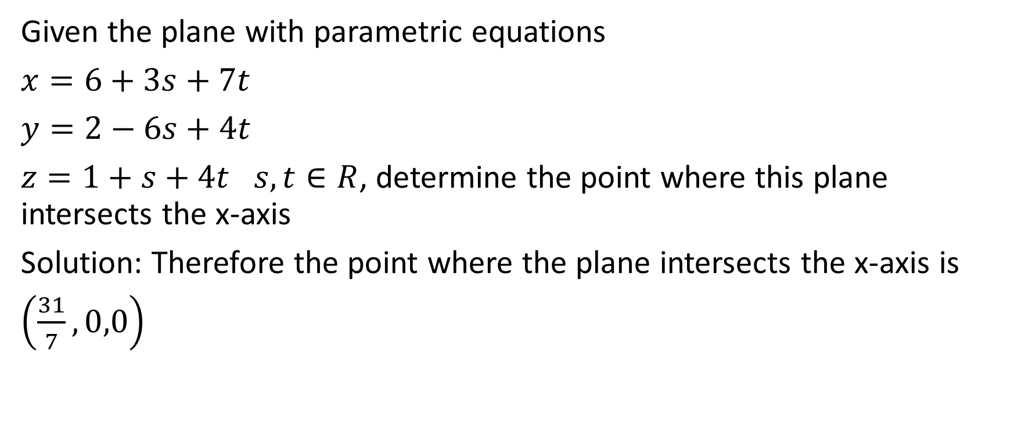
Given the plane with parametric equations
$x=6+3s+7t$
$y=2−6s+4t$
$z=1+s+4t$ $s,t∈R$, determine the point where this plane intersects the x-axis
Solution: Therefore the point where the plane intersects the x-axis is
$\left(\frac{31}{7},0,0\right)$

Slide 42

Example
Determine the vector equation of the plane that contains the point
A(0,-3, -2) and the line $\vec{r}=\vec{(3,−2,9)}+t\vec{(11,2,−3)}$.

Slide 43
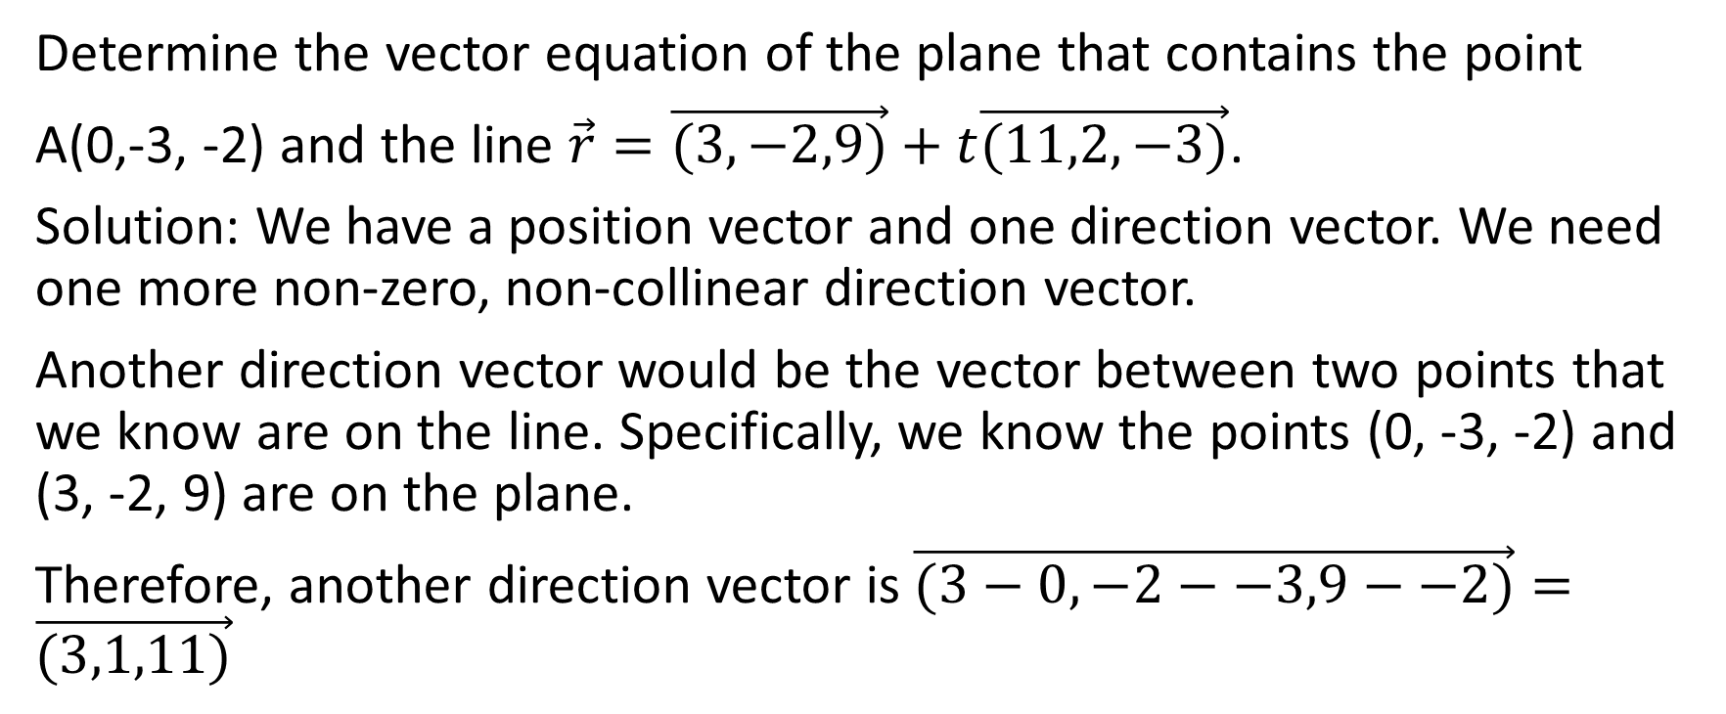
Determine the vector equation of the plane that contains the point
A(0,-3, -2) and the line $\vec{r}=\vec{(3,−2,9)}+t\vec{(11,2,−3)}$.
Solution: We have a position vector and one direction vector. We need one more non-zero, non-collinear direction vector.
Another direction vector would be the vector between two points that we know are on the line. Specifically, we know the points (0, -3, -2) and (3, -2, 9) are on the plane.
Therefore, another direction vector is $\vec{(3−0,−2−−3,9−−2)}=\vec{(3,1,11)}$

Slide 44
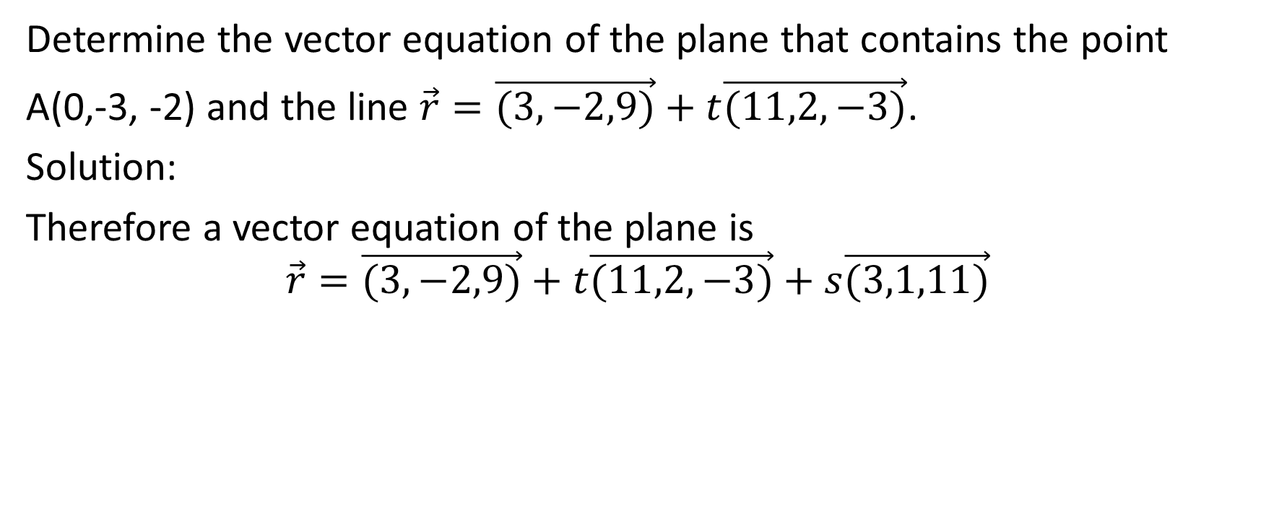
Determine the vector equation of the plane that contains the point
A(0,-3, -2) and the line $\vec{r}=\vec{(3,−2,9)}+t\vec{(11,2,−3)}$.
Solution:
Therefore a vector equation of the plane is
$$\vec{r}=\vec{(3,−2,9)}+t\vec{(11,2,−3)}+s\vec{(3,1,11)}$$

Slide 45

Example
Determine a vector equation of the plane that contains the intersecting lines
$L_{1}:\vec{r}=\vec{(−5,−13,−1)}+s\vec{(3,−9,4)}$ and
$L_{2}:\vec{r}=\vec{(−9,−13,−8)}+t\vec{(4,0,7)}$

Slide 46
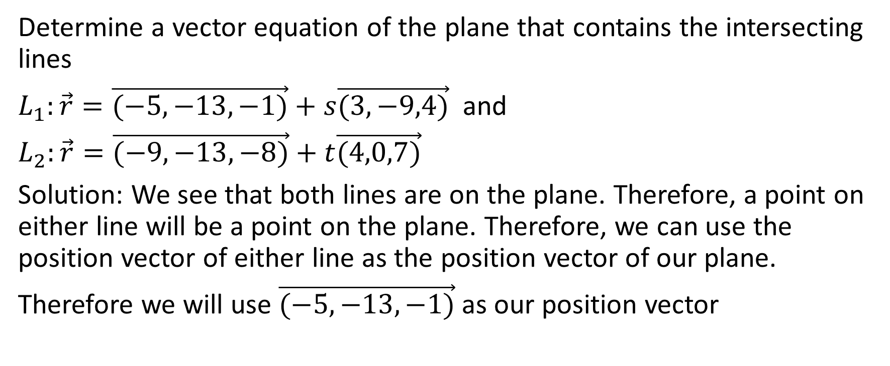
Determine a vector equation of the plane that contains the intersecting lines
$L_{1}:\vec{r}=\vec{(−5,−13,−1)}+s\vec{(3,−9,4)}$ and
$L_{2}:\vec{r}=\vec{(−9,−13,−8)}+t\vec{(4,0,7)}$
Solution: We see that both lines are on the plane. Therefore, a point on either line will be a point on the plane. Therefore, we can use the position vector of either line as the position vector of our plane.
Therefore we will use $\vec{(−5,−13,−1)}$ as our position vector

Slide 47
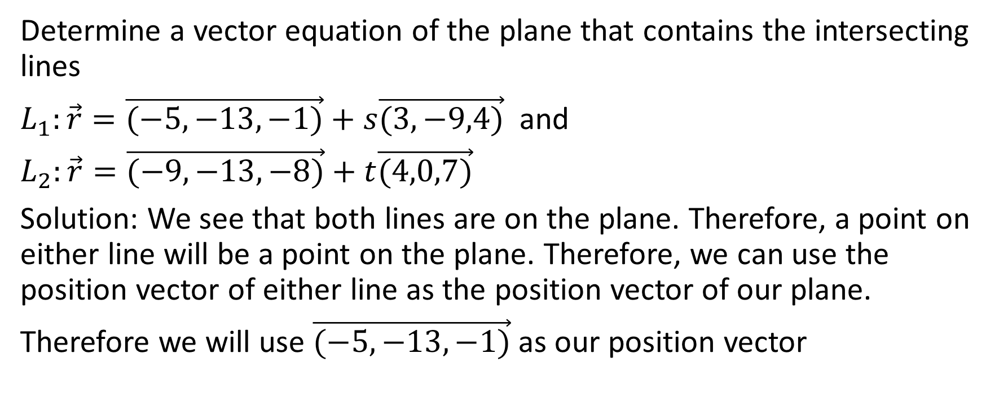
Determine a vector equation of the plane that contains the intersecting lines
$L_{1}:\vec{r}=\vec{(−5,−13,−1)}+s\vec{(3,−9,4)}$ and
$L_{2}:\vec{r}=\vec{(−9,−13,−8)}+t\vec{(4,0,7)}$
Solution: We see that both lines are on the plane. Therefore, a point on either line will be a point on the plane. Therefore, we can use the position vector of either line as the position vector of our plane.
Therefore we will use $\vec{(−5,−13,−1)}$ as our position vector
Note that we can’t multiply a position vector by -1 to make its first component positive because a position vector indicates a position. We can only do that with a direction vector, whether we are dealing with a line or a plane

Slide 48
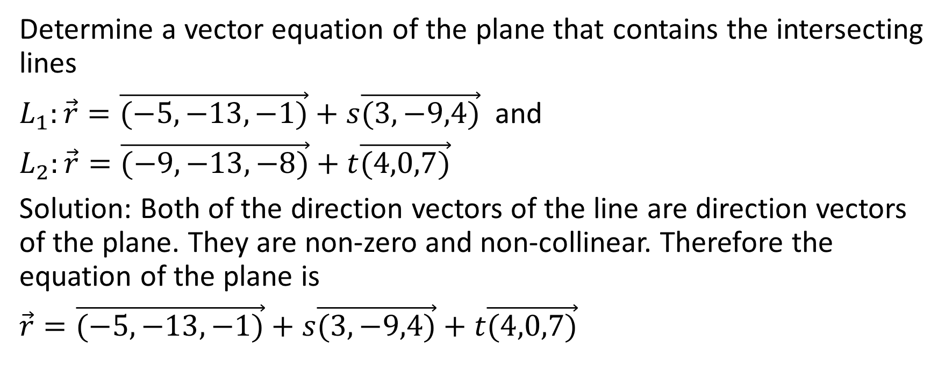
Determine a vector equation of the plane that contains the intersecting lines
$L_{1}:\vec{r}=\vec{(−5,−13,−1)}+s\vec{(3,−9,4)}$ and
$L_{2}:\vec{r}=\vec{(−9,−13,−8)}+t\vec{(4,0,7)}$
Solution: Both of the direction vectors of the line are direction vectors of the plane. They are non-zero and non-collinear. Therefore the equation of the plane is
$\vec{r}=\vec{(−5,−13,−1)}+s\vec{(3,−9,4)}+t\vec{(4,0,7)}$

Slide 49

Example
Determine the equation of the plane that contains the parallel and non-coincident lines
$L_{1}:\vec{r}=\vec{(−3,7,0)}+s\vec{(2,−7,1)}$ and $L_{2}:\vec{r}=\vec{(2,2,6)}+t\vec{(−4,14,−2)}$

Slide 50
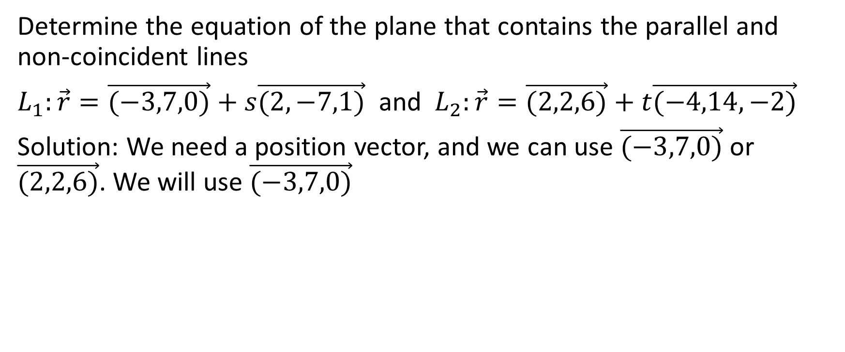
Example
Determine the equation of the plane that contains the parallel and non-coincident lines
$L_{1}:\vec{r}=\vec{(−3,7,0)}+s\vec{(2,−7,1)}$ and $L_{2}:\vec{r}=\vec{(2,2,6)}+t\vec{(−4,14,−2)}$
Solution: We need a position vector, and we can use $\vec{(−3,7,0)}$ or $\vec{(2,2,6)}$. We will use $\vec{(−3,7,0)}$

Slide 51
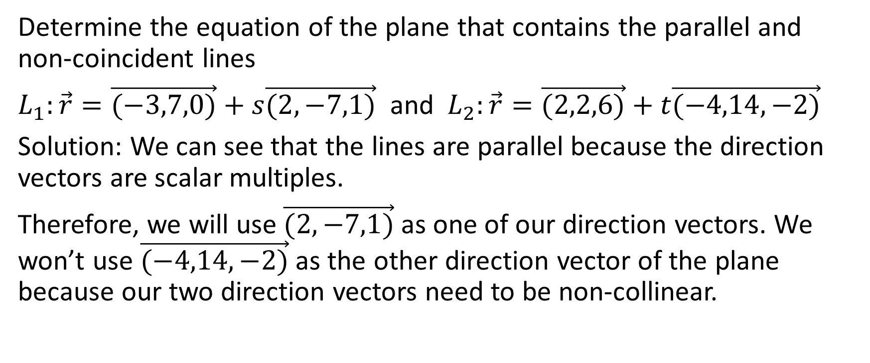
Determine the equation of the plane that contains the parallel and non-coincident lines
$L_{1}:\vec{r}=\vec{(−3,7,0)}+s\vec{(2,−7,1)}$ and $L_{2}:\vec{r}=\vec{(2,2,6)}+t\vec{(−4,14,−2)}$
Solution: We can see that the lines are parallel because the direction vectors are scalar multiples.
Therefore, we will use $\vec{(2,−7,1)}$ as one of our direction vectors. We won’t use $\vec{(−4,14,−2)}$ as the other direction vector of the plane because our two direction vectors need to be non-collinear.

Slide 52
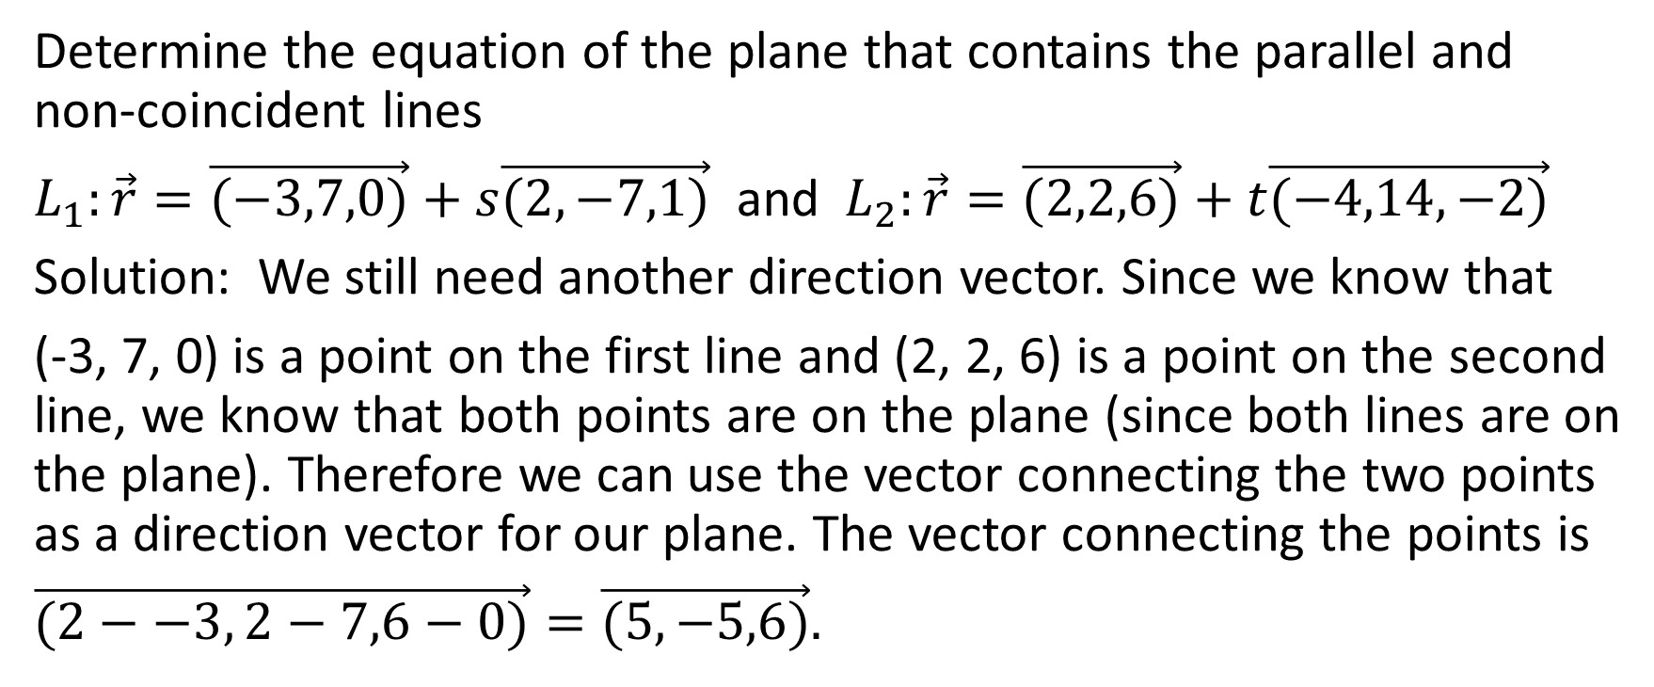
Determine the equation of the plane that contains the parallel and non-coincident lines
$L_{1}:\vec{r}=\vec{(−3,7,0)}+s\vec{(2,−7,1)}$ and $L_{2}:\vec{r}=\vec{(2,2,6)}+t\vec{(−4,14,−2)}$
Solution: We still need another direction vector. Since we know that
(-3, 7, 0) is a point on the first line and (2, 2, 6) is a point on the second line, we know that both points are on the plane (since both lines are on the plane). Therefore we can use the vector connecting the two points as a direction vector for our plane. The vector connecting the points is
$\vec{(2−−3, 2−7,6−0)}=\vec{(5,−5,6)}.$

Slide 53
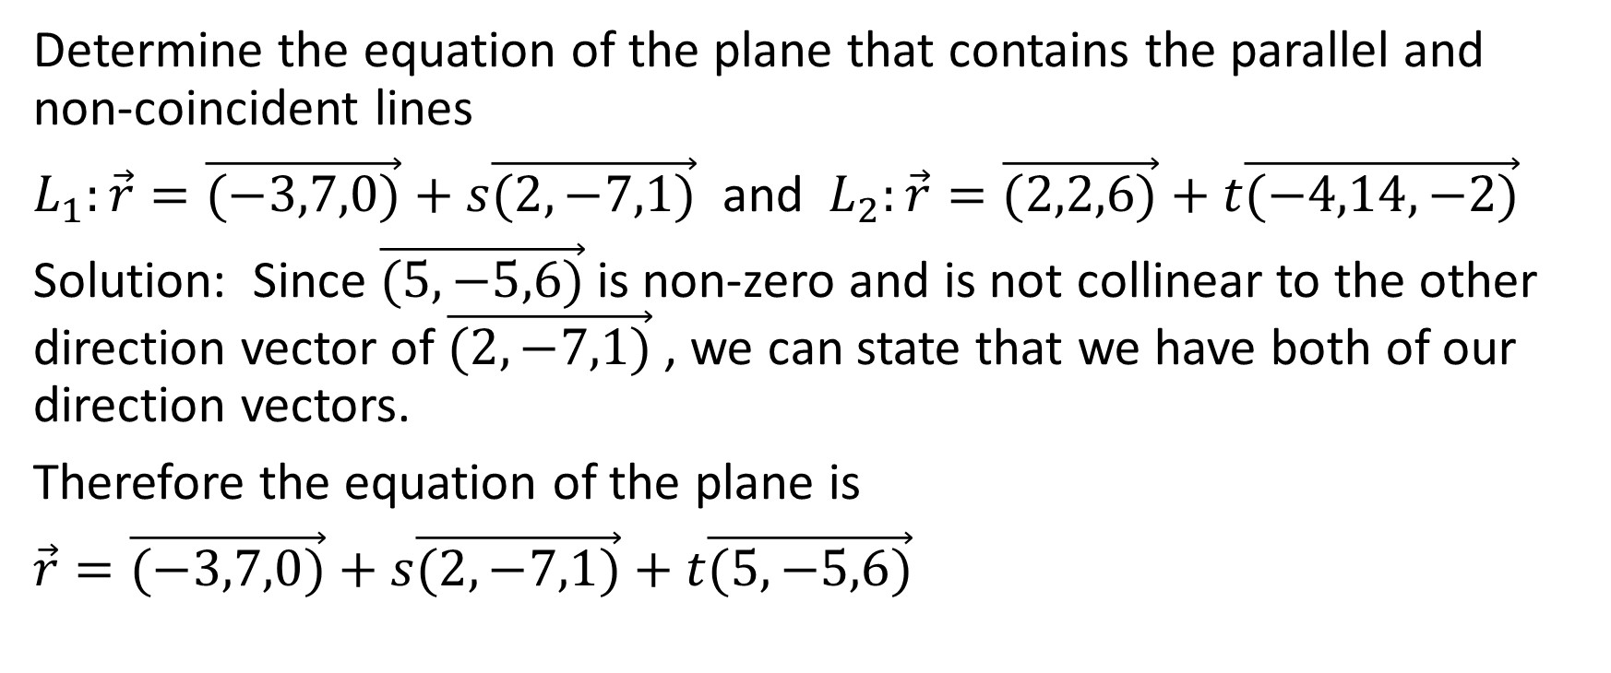
Determine the equation of the plane that contains the parallel and non-coincident lines
$L_{1}:\vec{r}=\vec{(−3,7,0)}+s\vec{(2,−7,1)}$ and $L_{2}:\vec{r}=\vec{(2,2,6)}+t\vec{(−4,14,−2)}$
Solution: Since $\vec{(5,−5,6)}$is non-zero and is not collinear to the other direction vector of $\vec{(2,−7,1)}$ , we can state that we have both of our direction vectors.
Therefore the equation of the plane is
$\vec{r}=\vec{(−3,7,0)}+s\vec{(2,−7,1)}+t\vec{(5,−5,6)}$

Slide 54

Example
Determine two lines that lie on the plane
$$\vec{r}=\vec{(1,−9,3)}+s\vec{(3,−2,1)}+t\vec{(1,−2,8)}$$

Slide 55

Example
Determine two lines that lie on the plane
$$\vec{r}=\vec{(1,−9,3)}+s\vec{(3,−2,1)}+t\vec{(1,−2,8)}$$
Solution:
That equation of the plane contains one position vector and two direction vectors.
If we use the position vector and one of the direction vectors, we get the equation of a line.
If we use the position vector and the other direction vector, we get the equation of another line.

Slide 56

Example
Determine two lines that lie on the plane
$$\vec{r}=\vec{(1,−9,3)}+s\vec{(3,−2,1)}+t\vec{(1,−2,8)}$$
Solution:
Therefore, the two lines are
$L_{1}:$ $\vec{r}=\vec{(1,−9,3)}+s\vec{(3,−2,1)}$ and
$L_{2}:$ $\vec{r}=\vec{(1,−9,3)}+t\vec{(1,−2,8)}$

